Slide 2
Caution:
This guide is a work in progress and should be treated with a healthy dose of skepticism. The values in the following screenshots are not recommendations.
This guide is NOT a supplement for training on the system. This guide shows how to start from the CAD file to a working Gcode. Process parameters, etc., are not covered herein.
This guide is a reference booklet for starting with Netfabb and the custom CLI –> Gcode postprocessor.
This guide assumes that:
Netfabb is installed (free access using an educational account)
Matlab is installed for running the post-processer
As of writing, the post-processor is only functional as a Matlab script.
You know how much powder to the dispenser and the process parameters you will use.

Slide 3
It starts in CAD
You need a geometry, to begin with
Draw it yourself using Solidworks, Fusion, Onshape, etc.
Or get from elsewhere, e.g., Thingiverse, Printables, etc.
Note: This is not a guide on how to produce the 3D files for printing. It is assumed that you can do everything up until importing into Netfabb.
Requirements:
Netfabb accepts the most common file formats. It is recommended to use the native CAD format directly to avoid loss of details, data corruption, etc. For a complete list, refer to the Netfabb documentation. Used files include, but are not limited to:
STL (not recommended, but possible)
SLDPRT (Solidworks) or another native CAD format
STEP, X_T, IGES, etc., are generic formats, and most CAD software can import and export these file types.
Post-processor only accepts CLI files formatted as shown on the following pages.
If you want to slice using the OpenAM slicer, you need a STL with limited polygons. For help using the OpenAM slicer, find the OpenAM slicer guide.

Slide 4
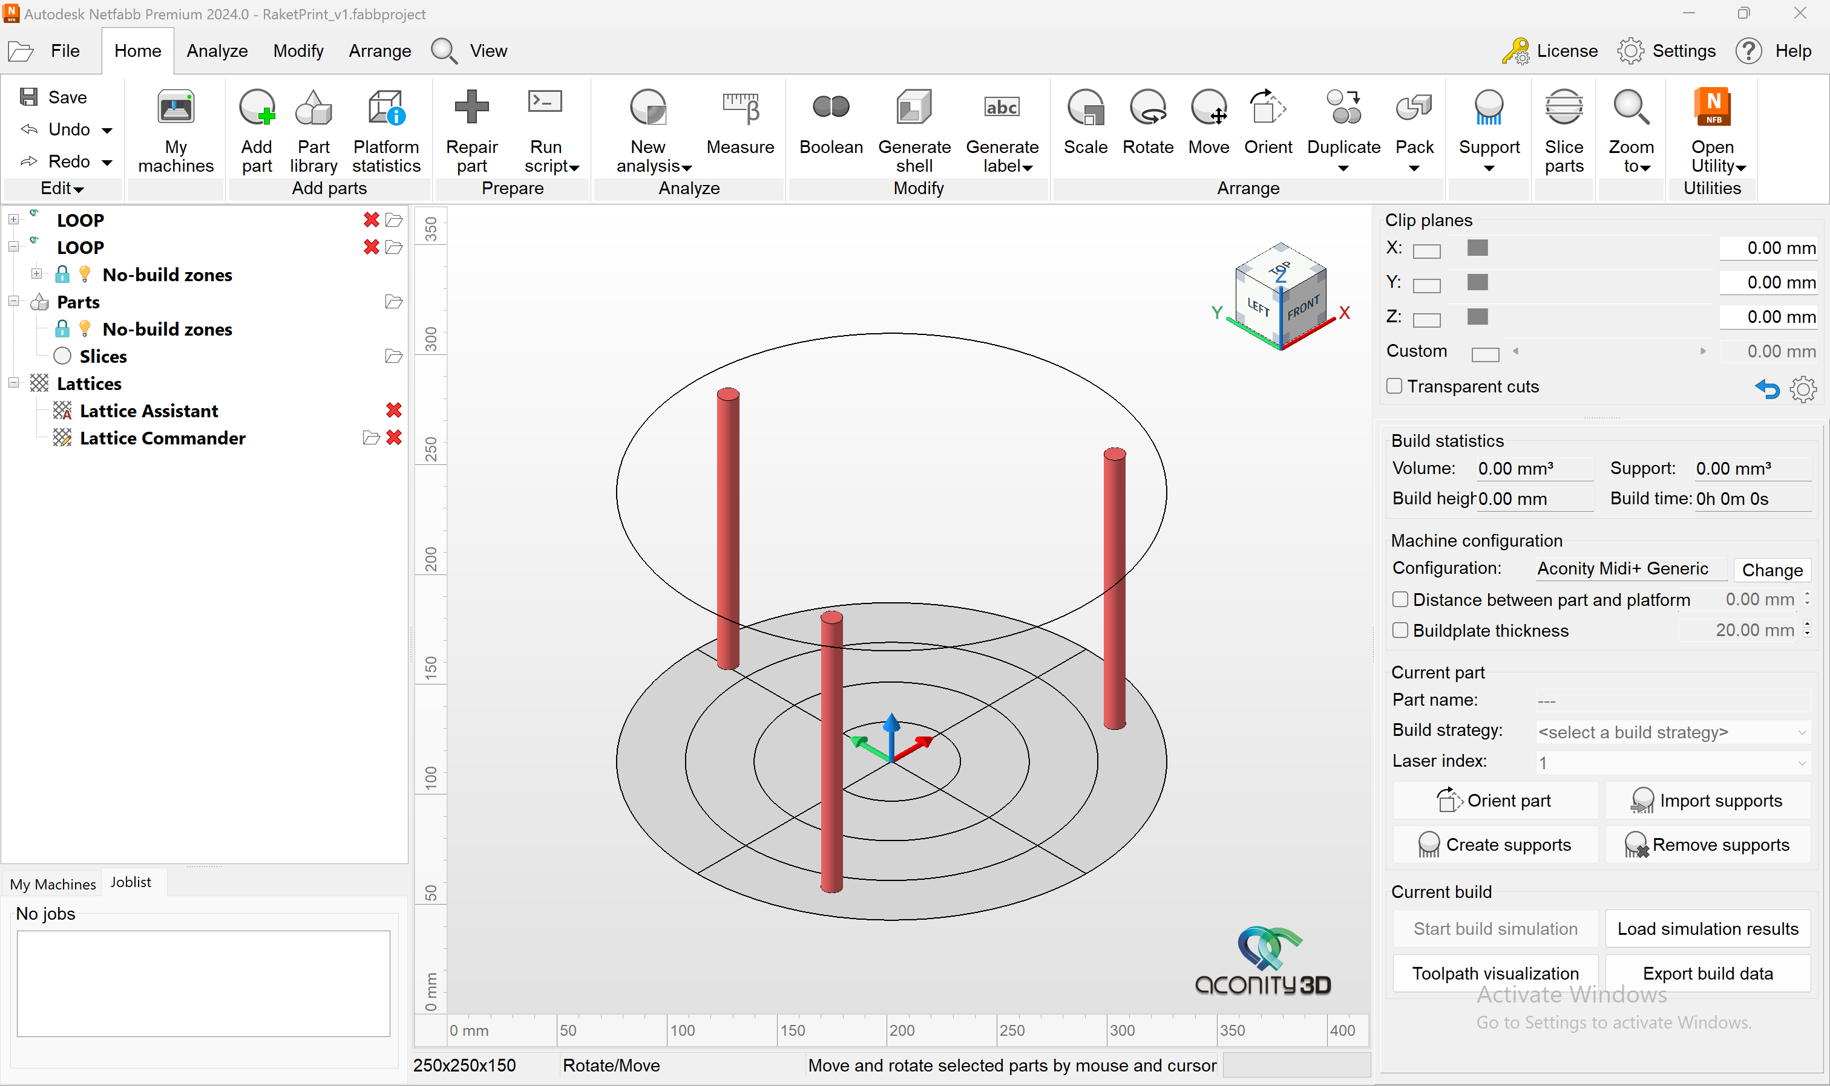
Optional: Setting up Netfabb
Download the two files (one XML and one 3MF) from the post-processors GitHub page and save them in a known folder. E.g., …/Documents/NetfabbSetup
Add "Aconity Midi+" machine
Click the Pencil-icon at the top right corner of the "My Machines" window.
Change the name to "LOOP” in the top textbox.
Check the "Customized machine" box at the bottom and change the Z-height to 150mm.
Click on "Save machine."
Right-click on the new "LOOP" machine on the left and select "Import machine settings.”
Import the “Netfabb LOOP Settings.xml” that you saved previously.
Click on the Gear-icon next to the Pencil-icon.
Under “Custom machine: use custom no-build zones,” choose the path to the "LOOP ONE No Build Zone.3MF” that you saved previously.
Click on "Save"
Done
Result: Shows the three screw locations and moves the origin to the middle of the build plate for easier alignment.

Slide 5
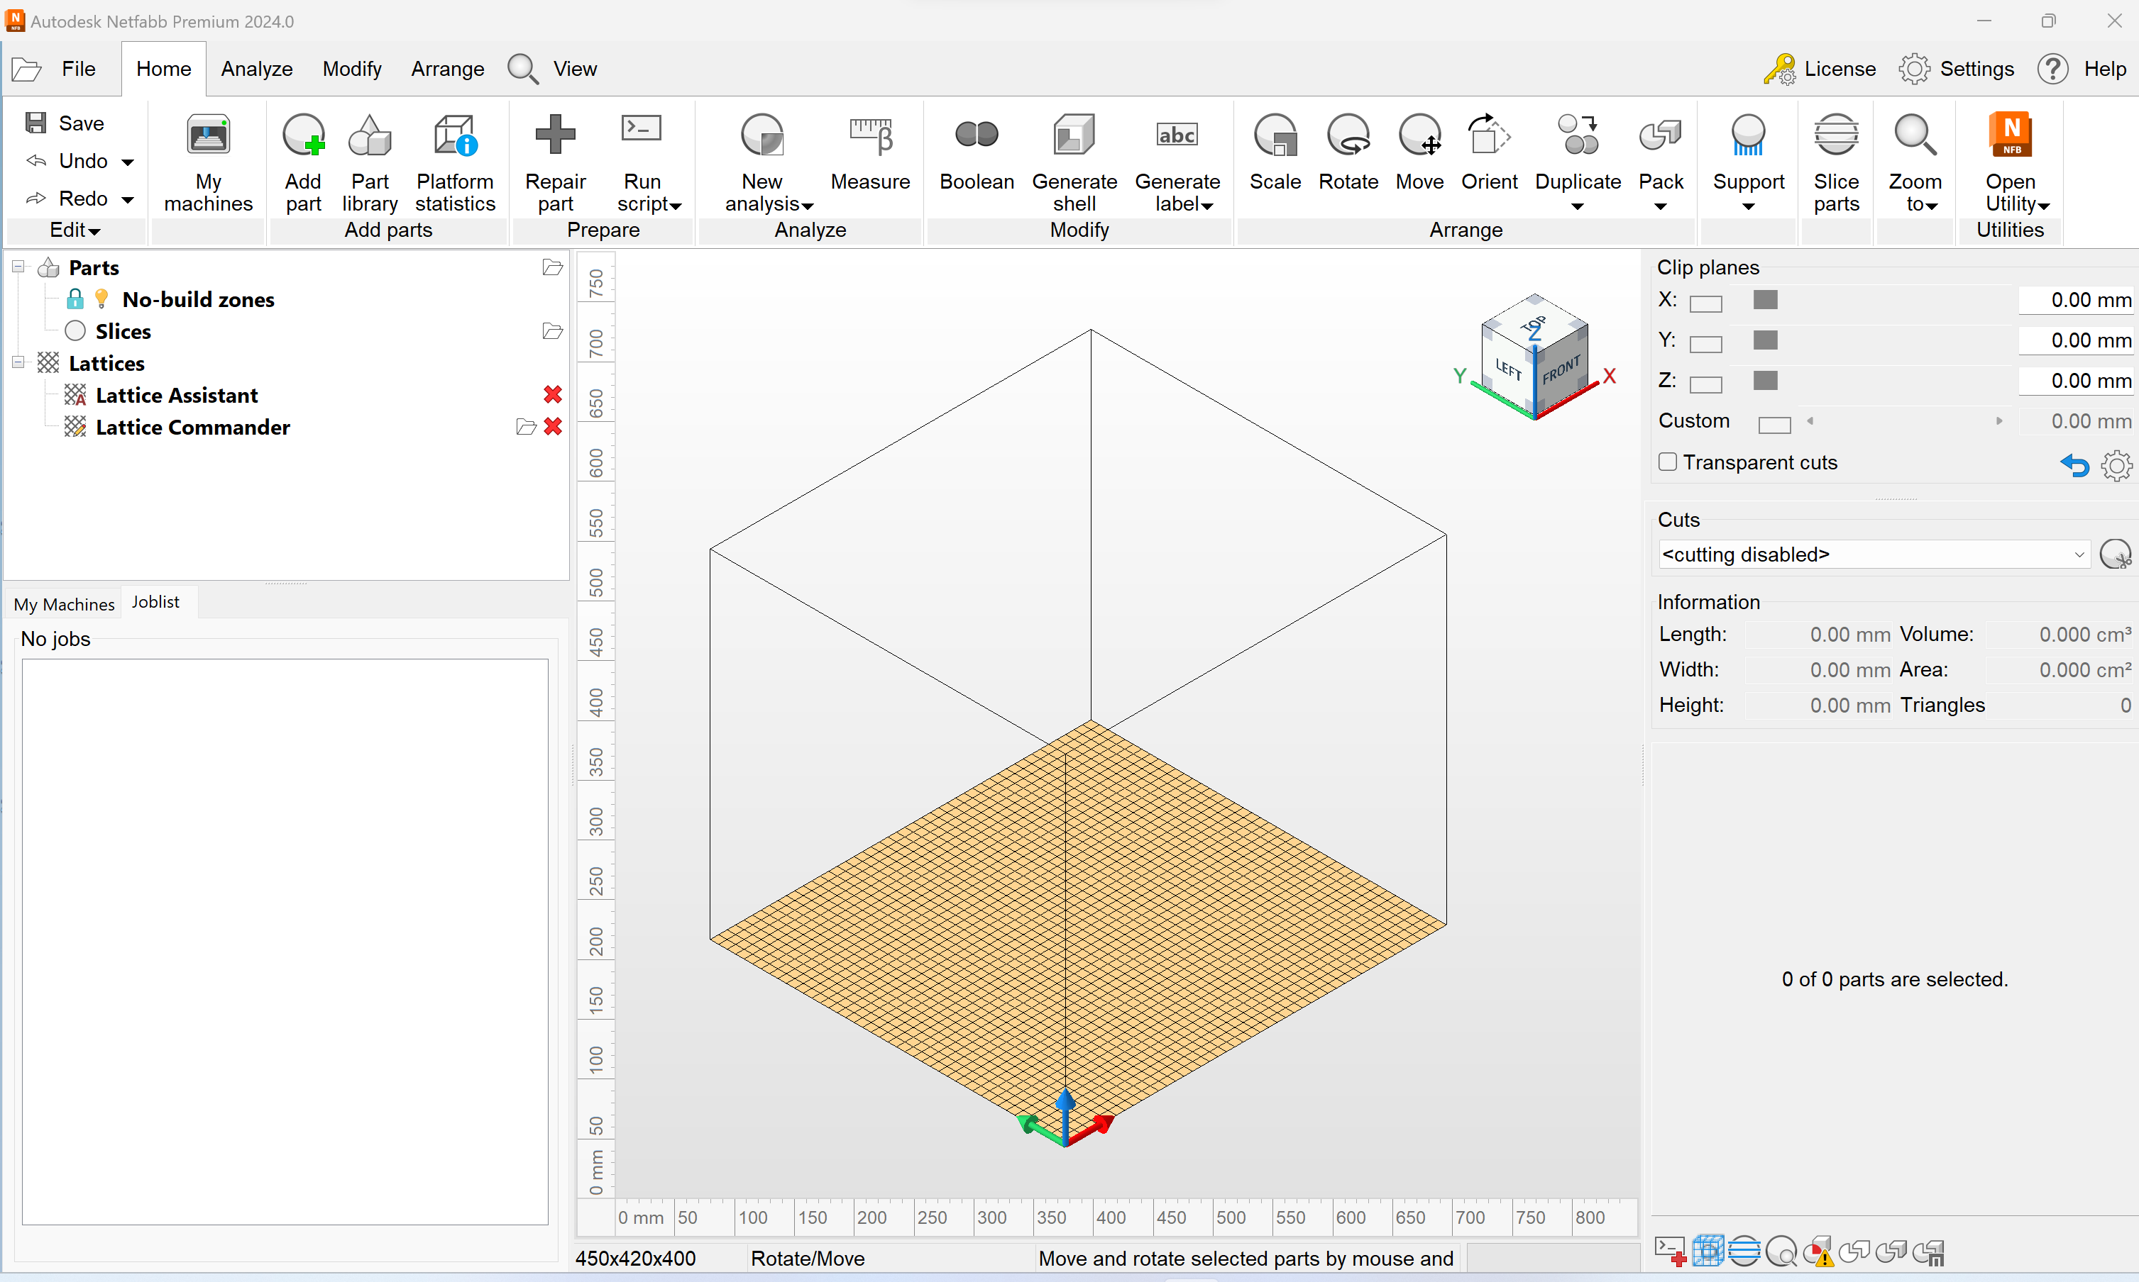
Opening Netfabb
1)
You should set up a custom printer profile; however, while not strictly necessary, the images do not assume so.

Slide 6
Import file(s)
Click Add part
Browse to geometry and press open
[Picture 2)] If you choose a CAD-file (i.e., not an STL) you will get to select a tessellation level (level of detail). For simple geometries, Medium might be fine. Otherwise, select higher detail levels. Click add parts.

Slide 7
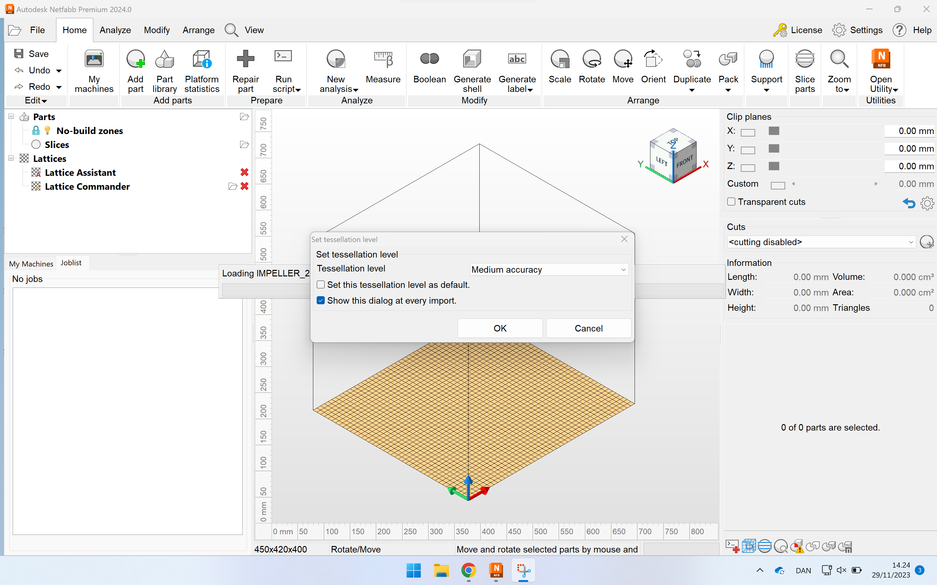
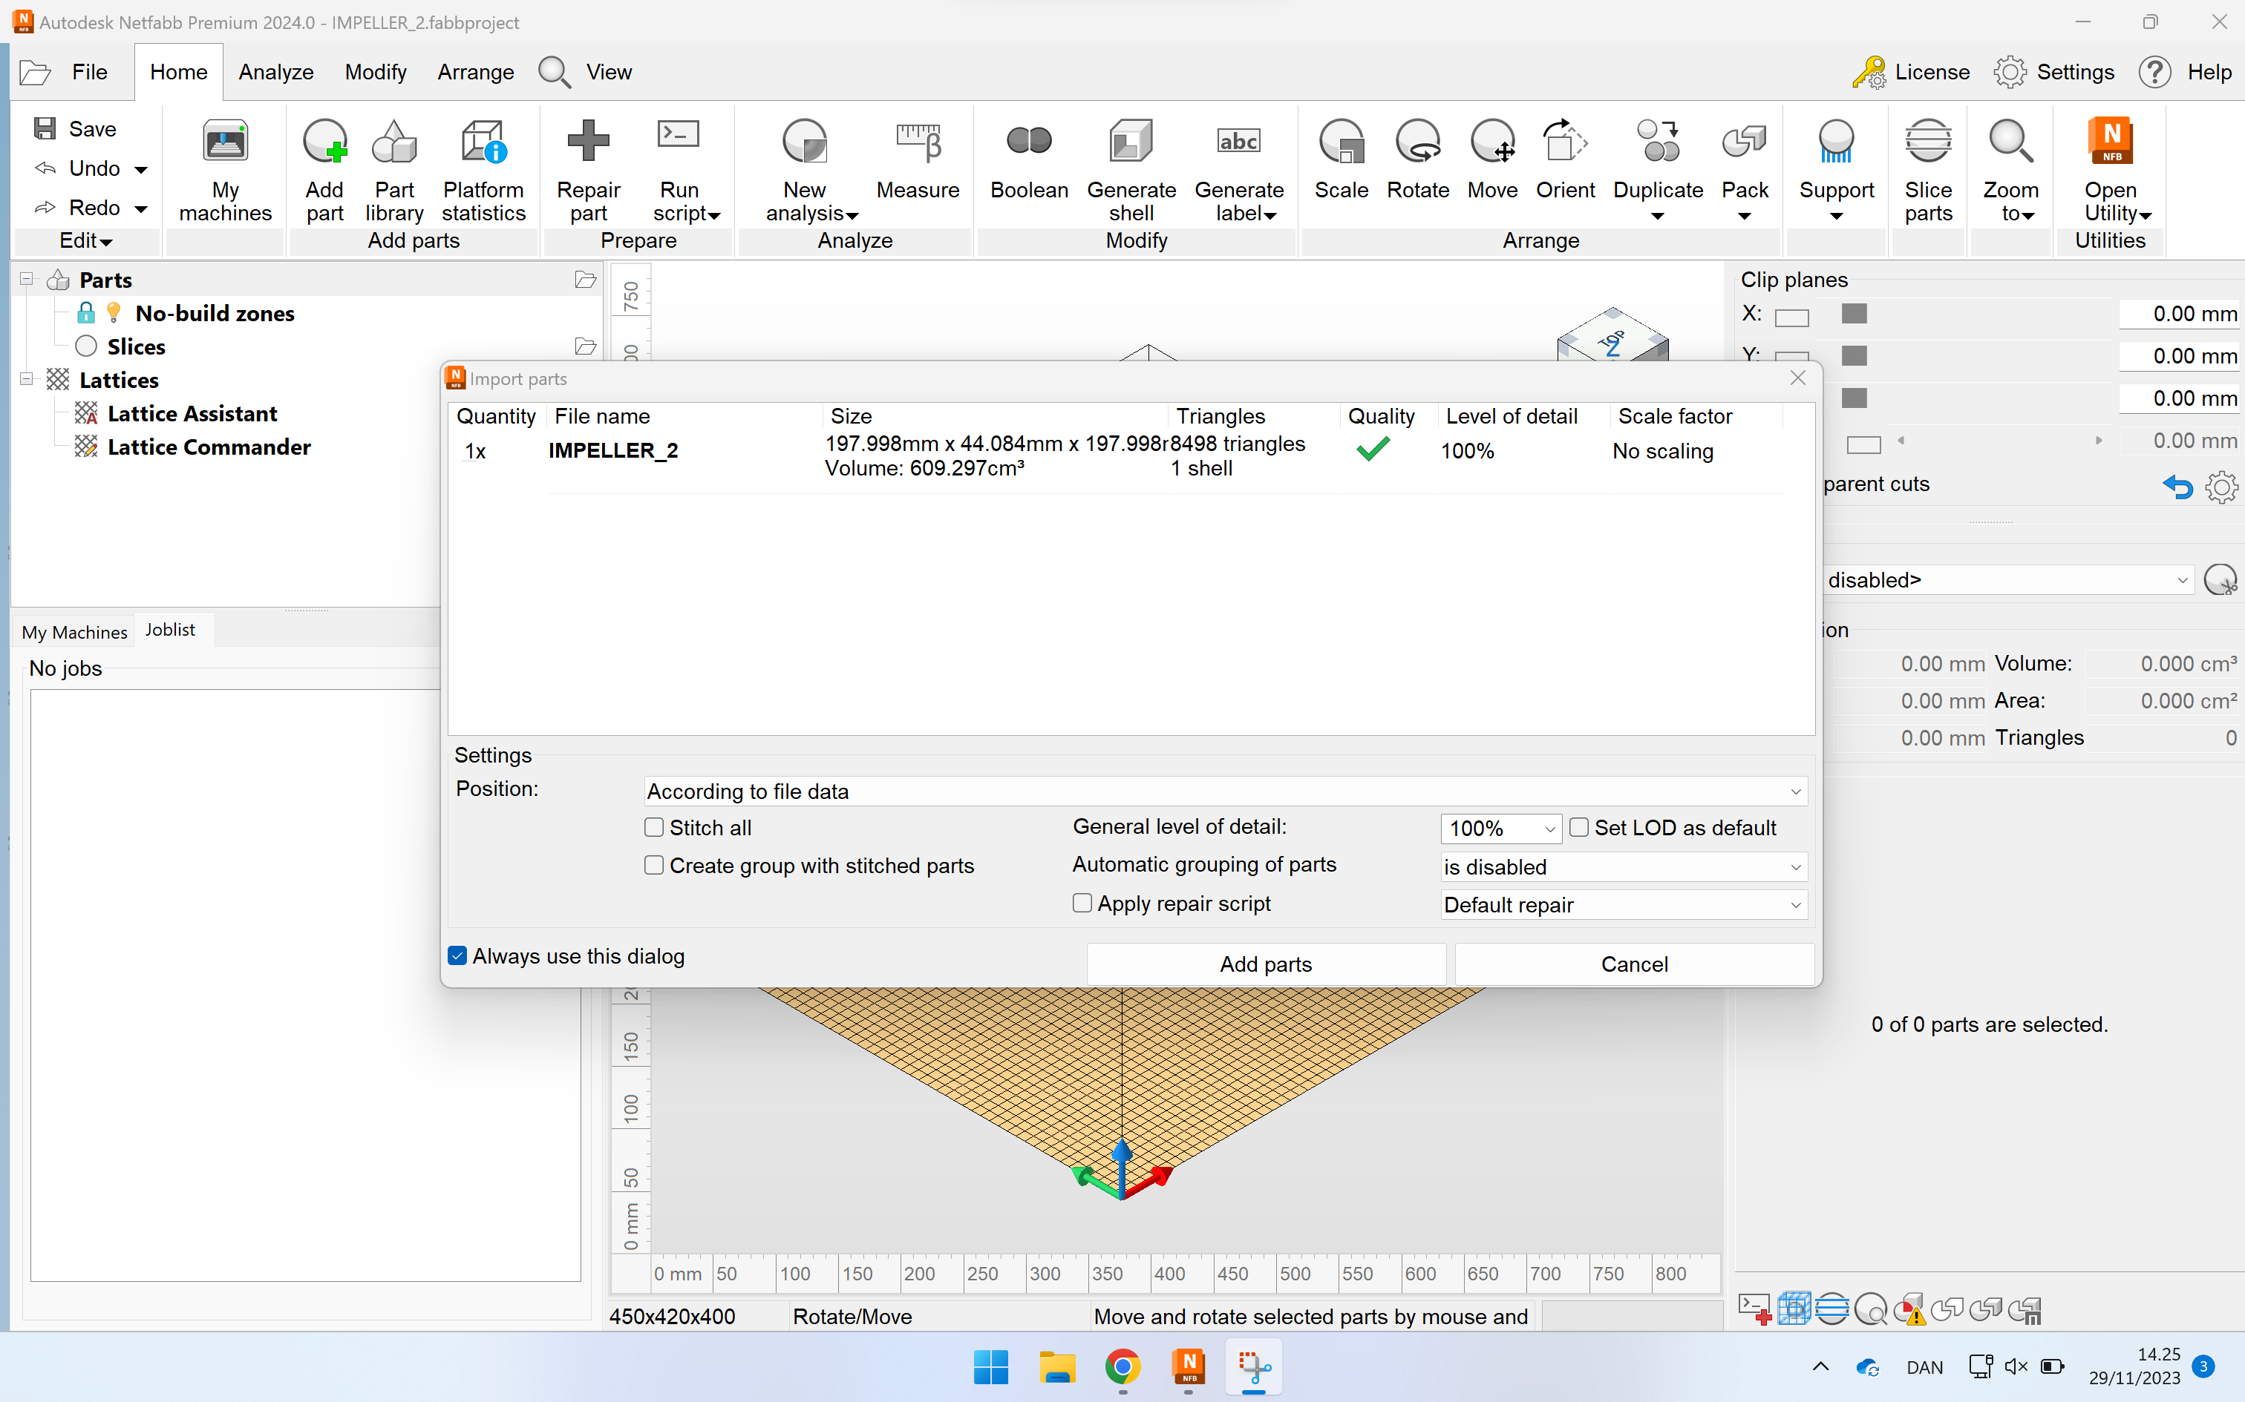
2)
3)

Slide 8
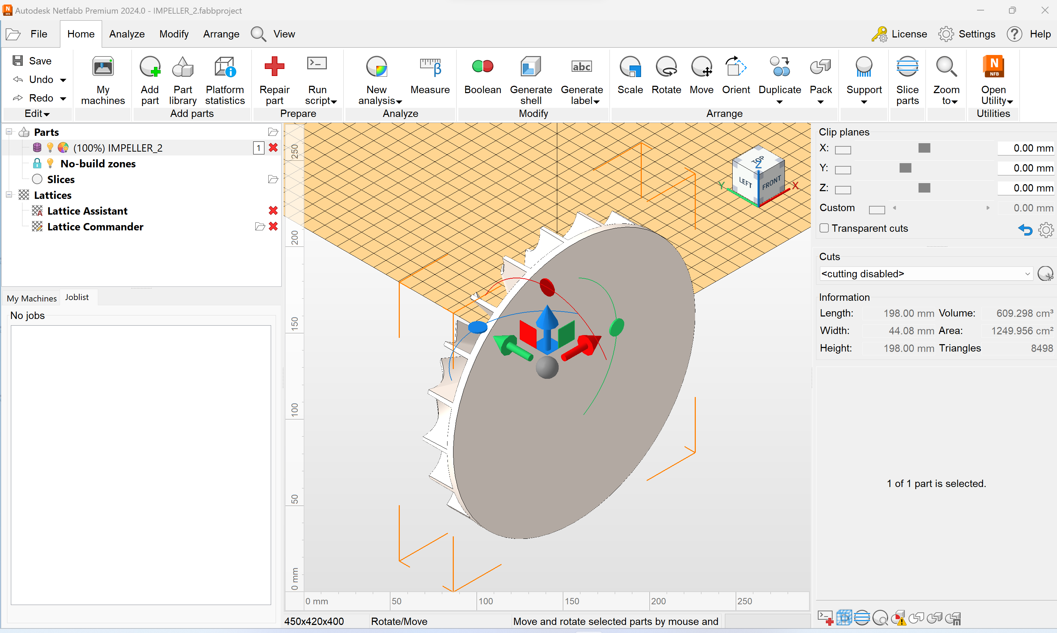
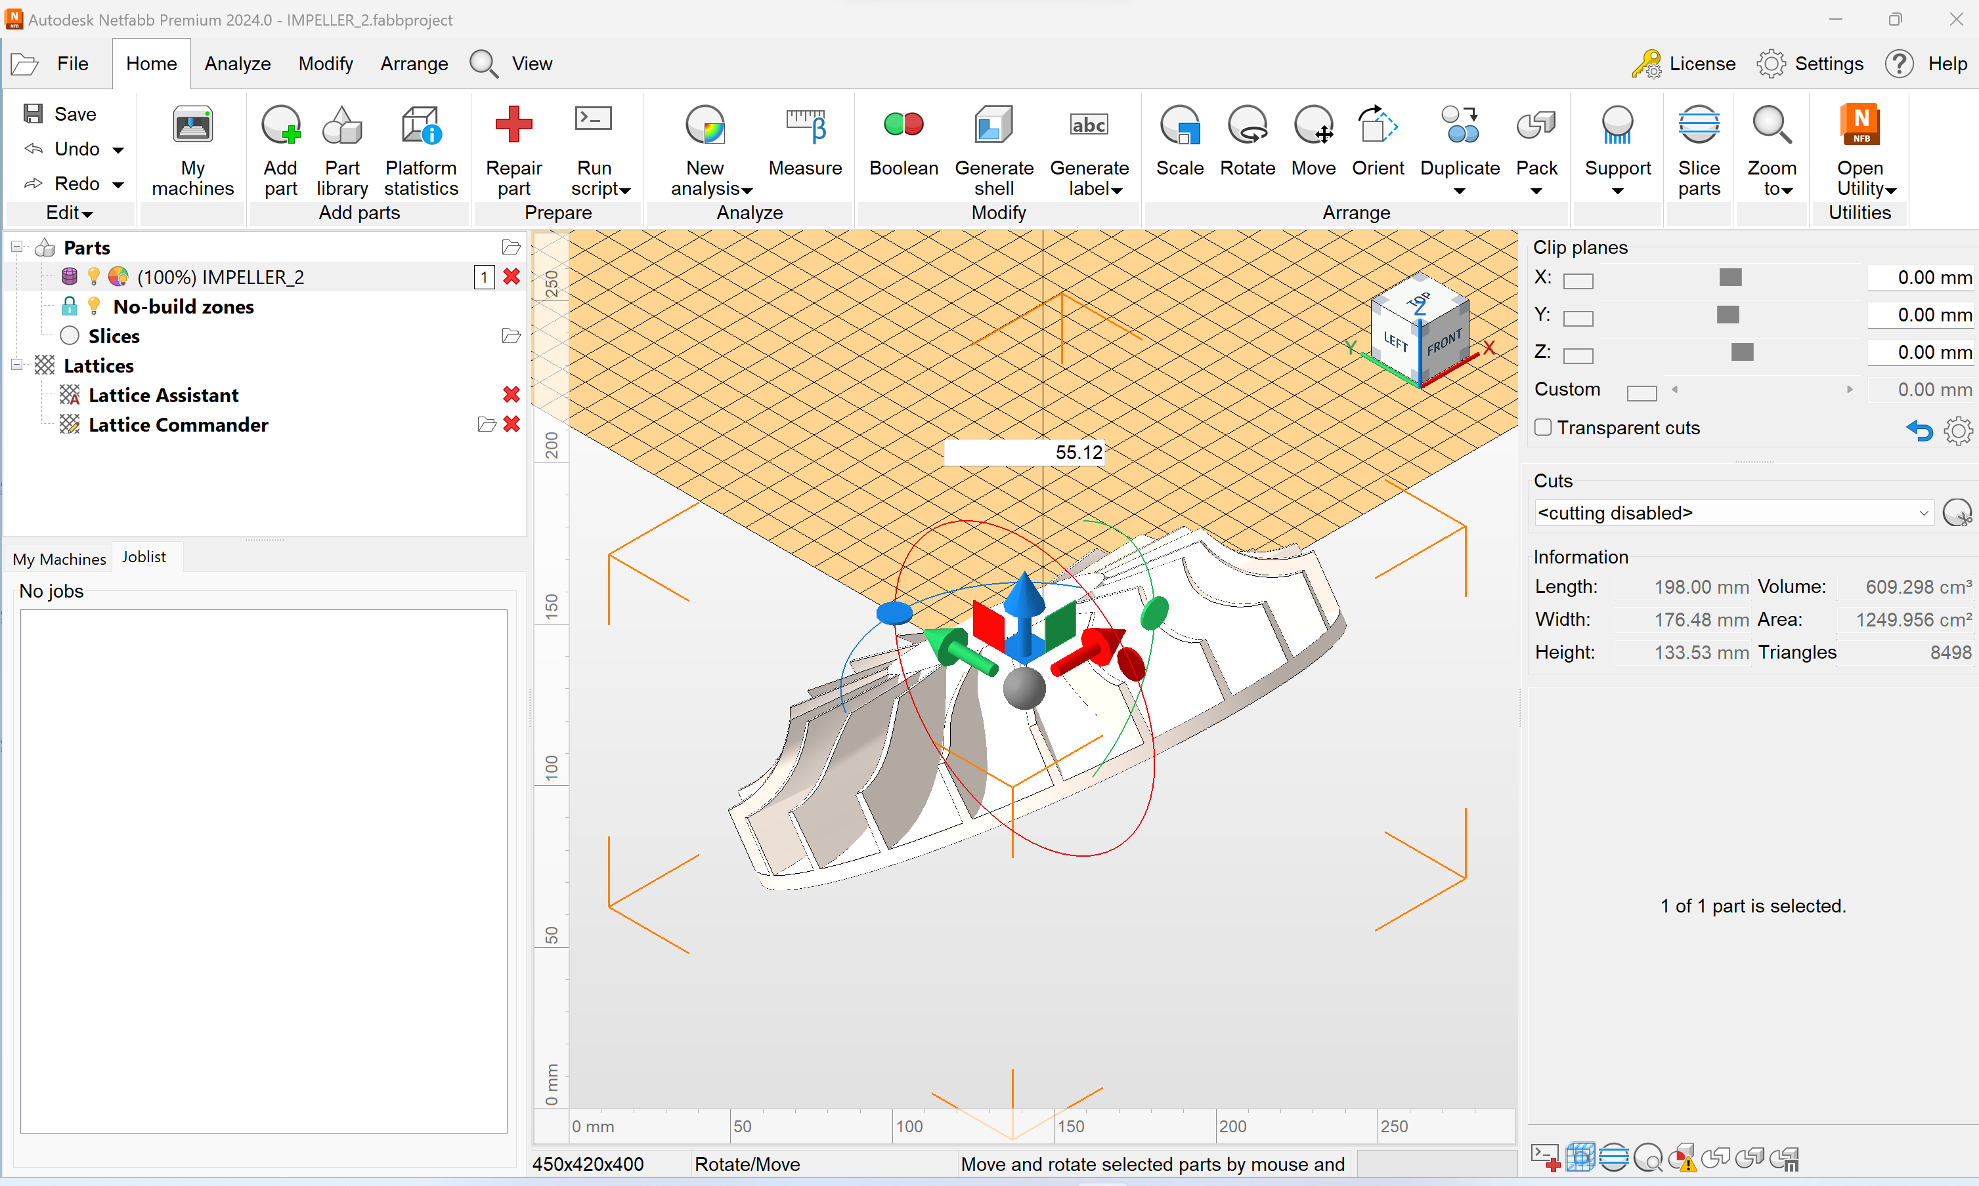
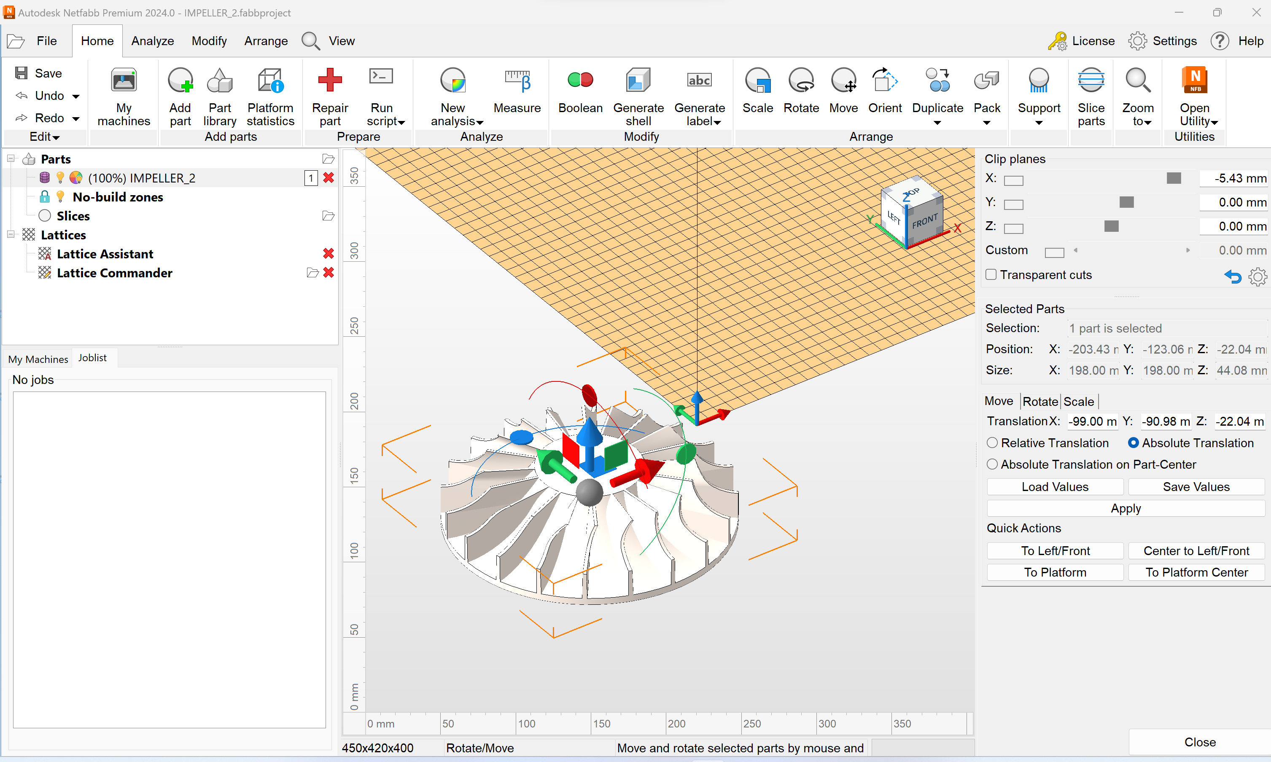
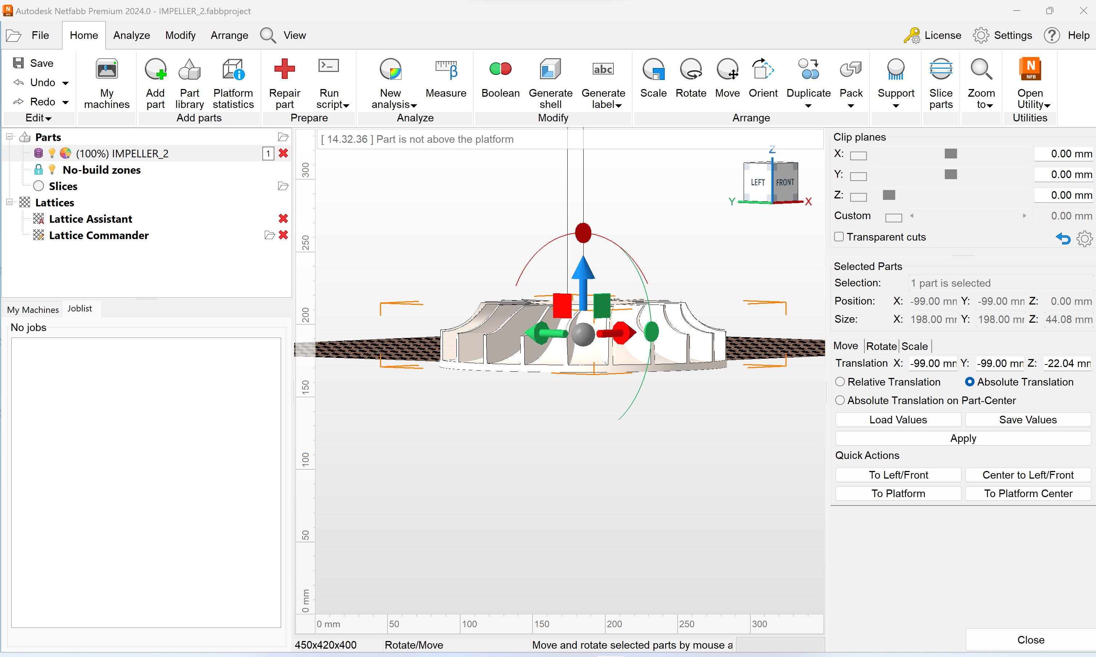
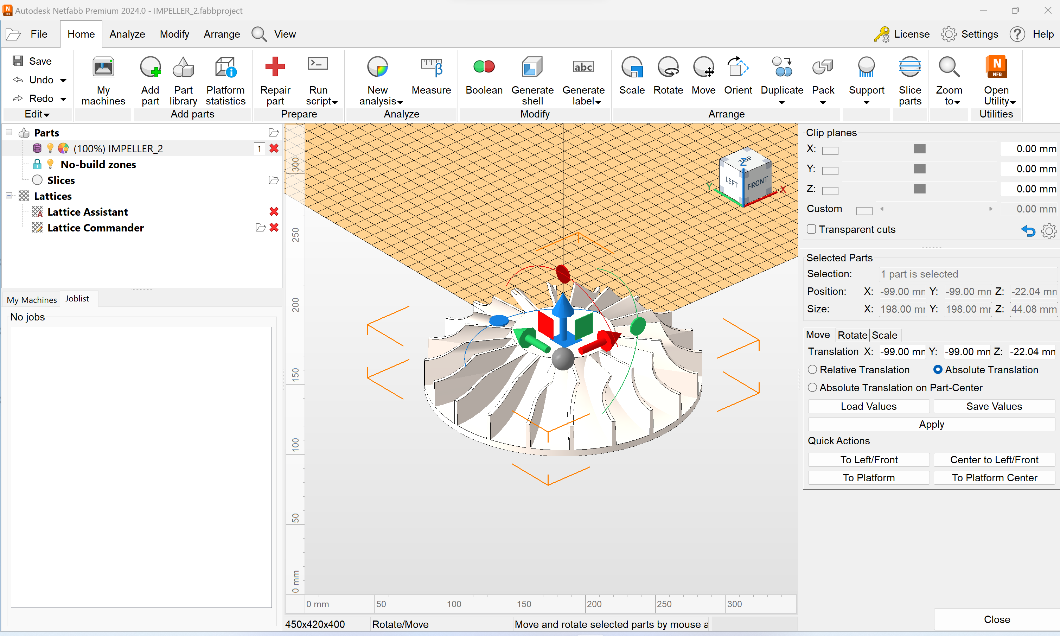
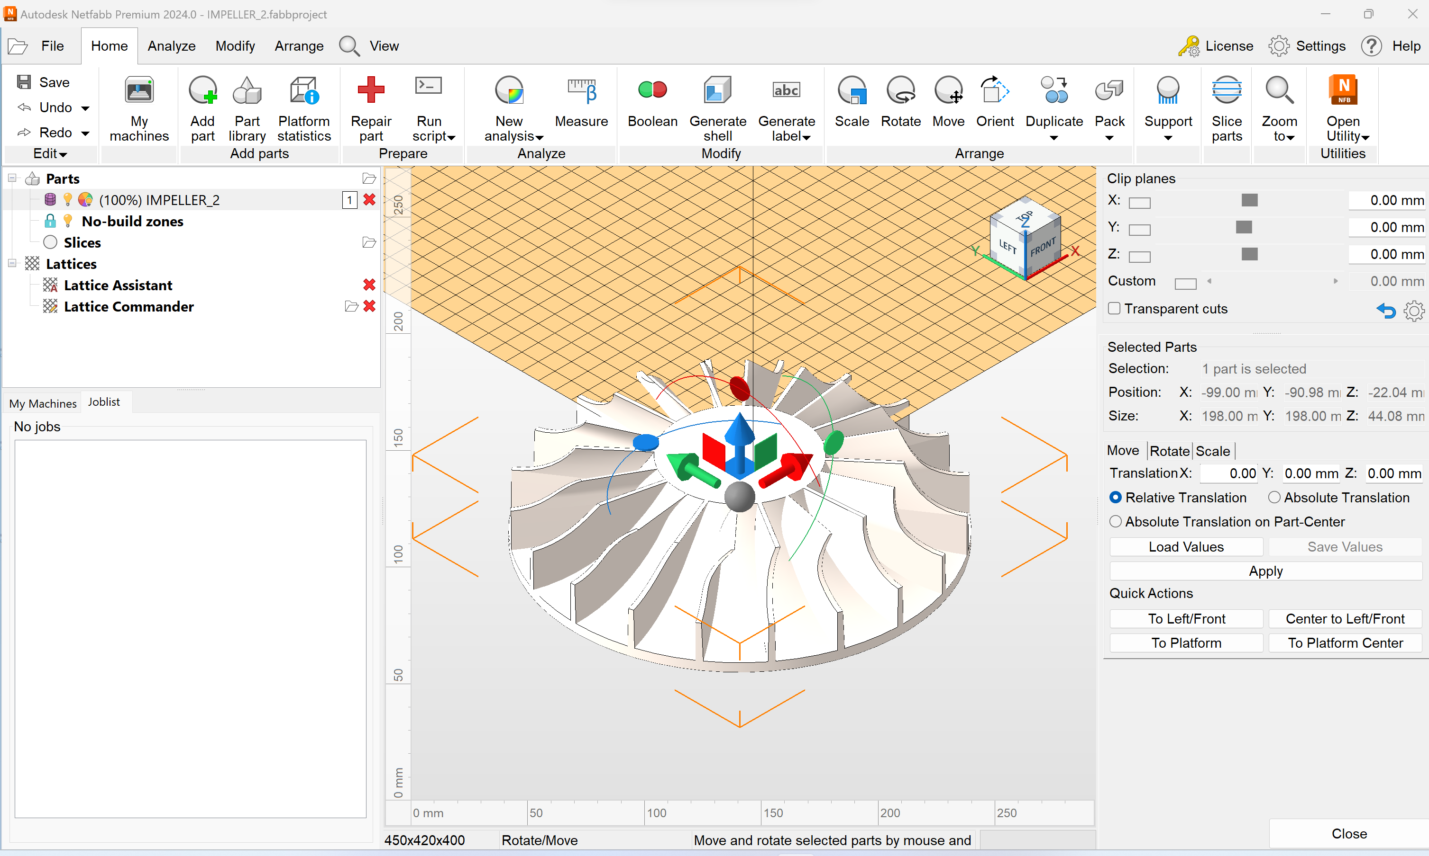
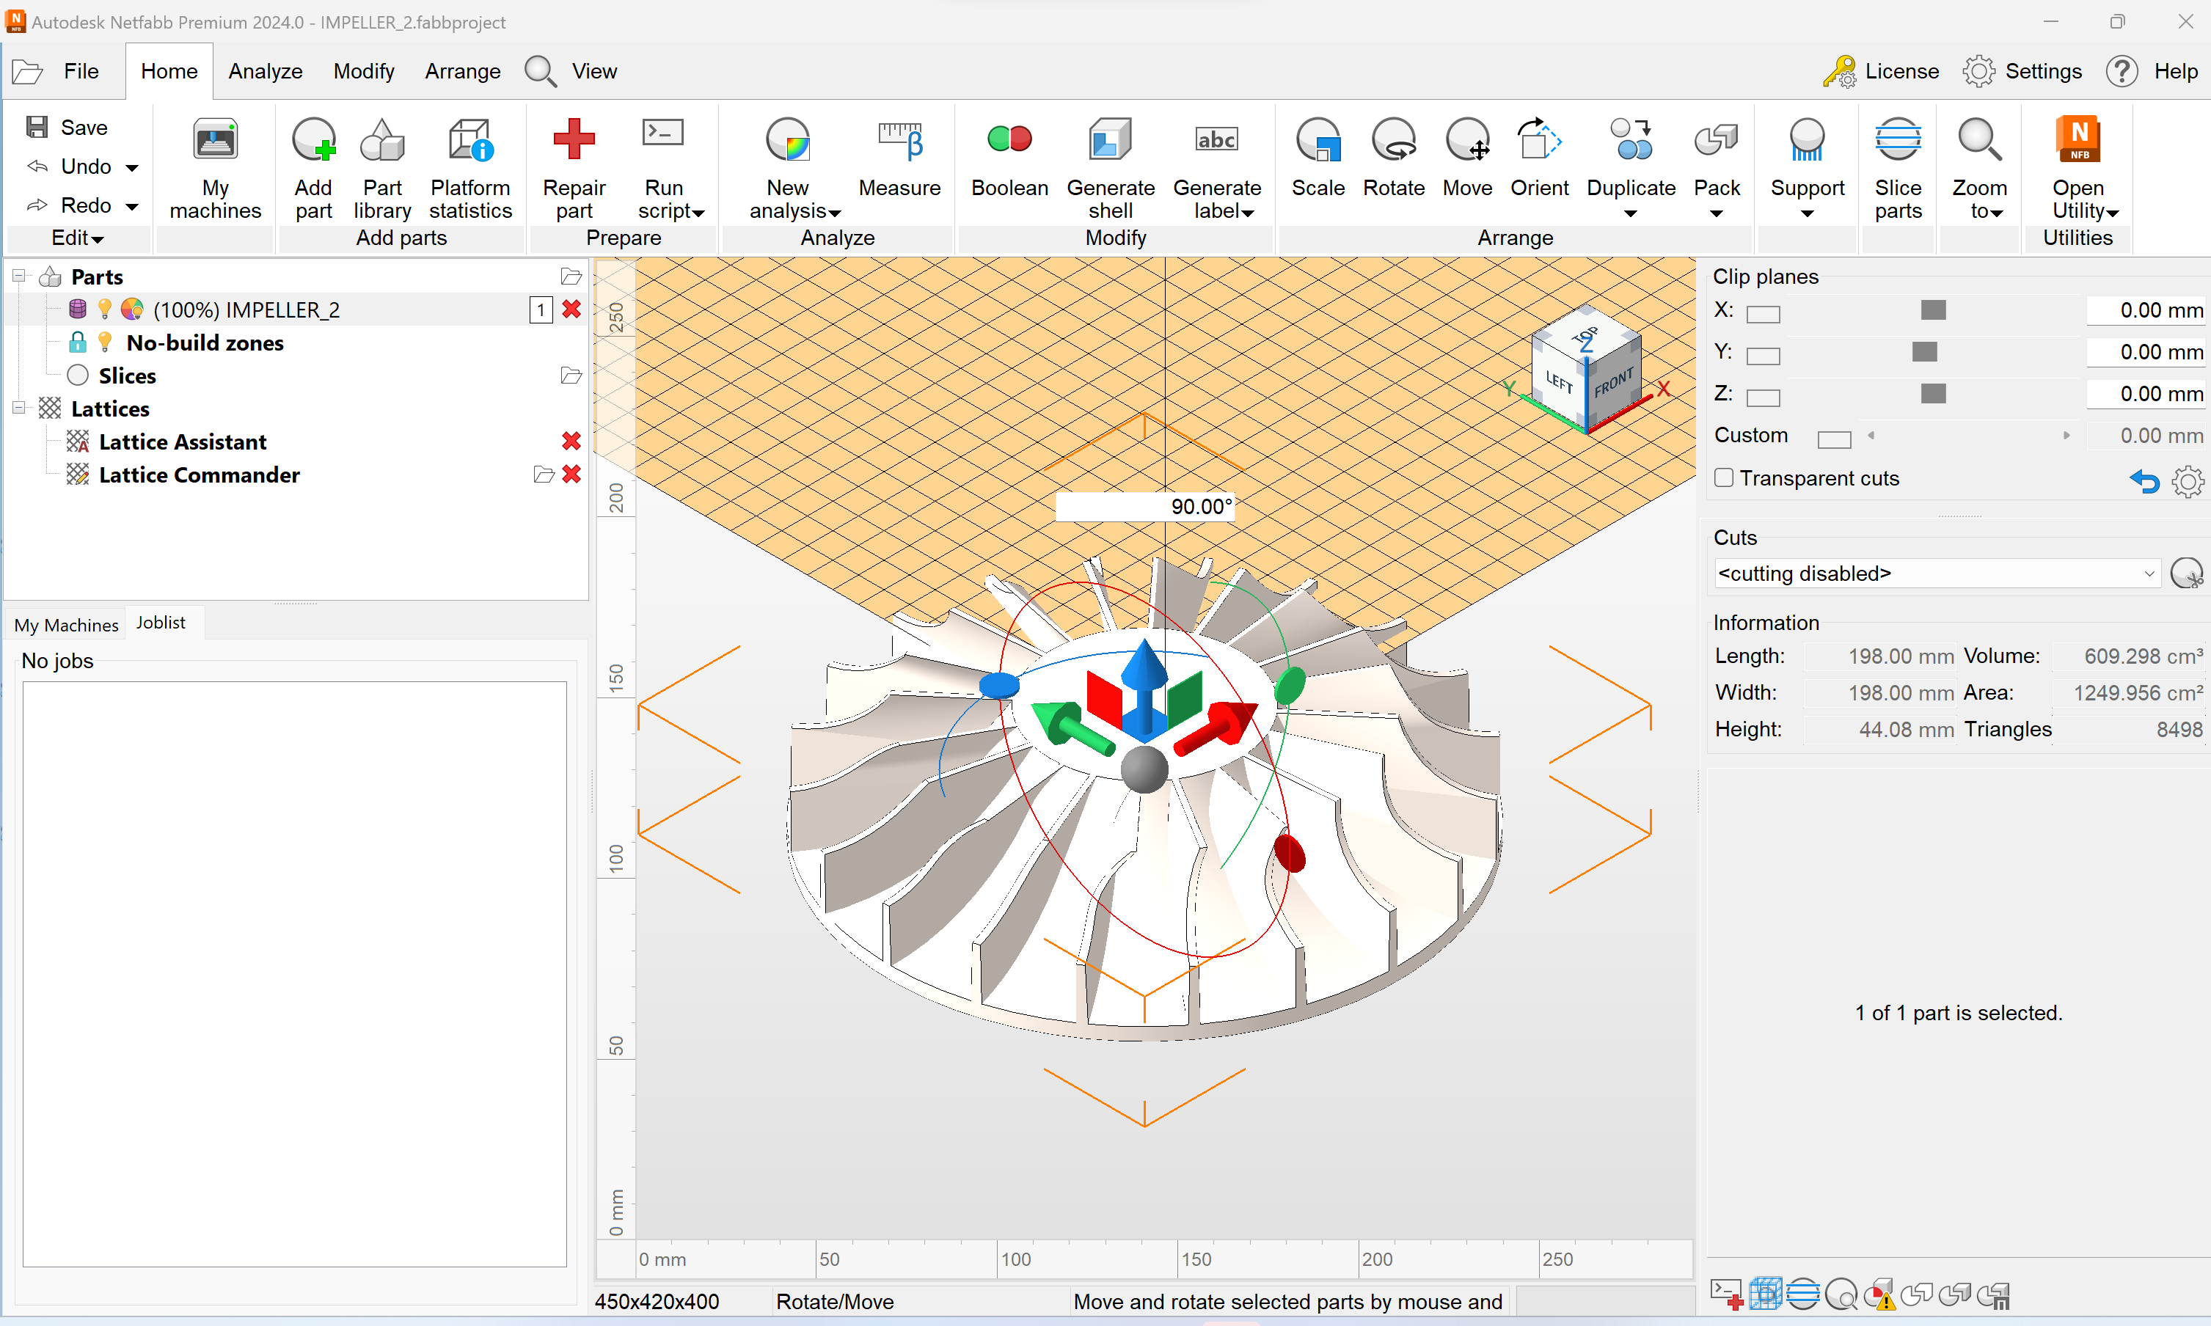
Orient the part
4)
5)

Slide 9
Netfabb
Press Keep Editor after applying the support.
Select the part(s) you wish to slice.
You do not have to select all, but you do need to select one. You can reposition the slices, but it is advised to place the 3D object where you want them, to ensure proper placement.

